Slide 1
Czech Technological Platform “Interoperability of the Railway Infrastructure”
www.sizi.cz
Presented by:
Otto Plášek and Leoš Horníček

Slide 2
Czech Technological Platform Interoperability of the Railway Infrastructure
The association has been established as a corporate body on 4th January 2008.
The main objective is to join the scientific and technical potential of universities, research and project institutes together with the production potential of construction and production companies for the implementation of the following objectives and the subject of activities:
Support of innovations and the increase of competitiveness of the members of the association.
Support of the implementation of research and development projects with the requirements of the technical interoperability specifications of the Trans-European railway system in the sub-systems of infrastructure, energy, control command and signalling and interface among subsystems.
Acquiring of financial support for the implementation of projects.
The involvement of the members of the Association into international (European) activities related to the development process of new European legislation for construction, production and maintenance as well as related tests and the evaluation of the production of the European railway industry.

Slide 3
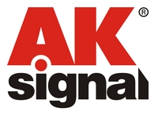
Czech Technological Platform Interoperability of the Railway Infrastructure
Association of 22 members:
Universities, technical college:
Czech Technical University in Prague;
Brno University of Technology;
University of Pardubice;
Technical college Decin.
Research institutes:
Railway Research Institute (VUZ);
VÚKV (Research Institute for rolling stock).
Technical and test institutes:
Technical and Test Institute for Construction Prague (TZÚS).
Design, contractor and industrial companies:
track;
control command and signalling;
energy;
interface among systems.
Associated member:
RIA (SŽDC)

Slide 4
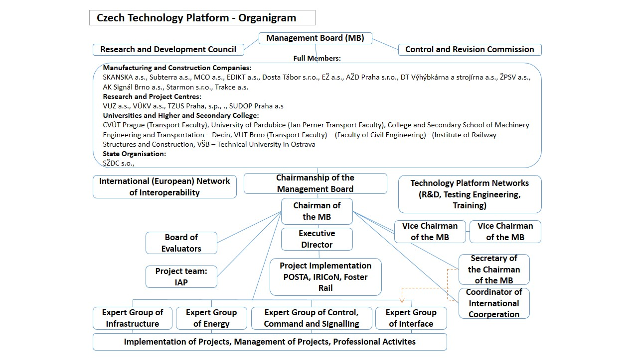
Organizational Structure of TP

Slide 5
TP Member’s Participation in national programmes
a) Operational programmes in the period 2007 – 2013 with financial support from the Structural Funds of the European Union:
Operational Programme Enterprise and Innovations (OP EI)
Ministry of Industry and Trade of the Czech Republic
Operational Program Education for Competitiveness (OP EC)
Ministry of Education, Youth and Sports of the Czech Republic
b) Czech Science Foundation (GACR)
Science and research:
“Development and testing fiber-concrete characteristics fulfilling present requirements for transport tunnel lining” (CVUT – Czech Technical University in Prague), duration 01/2010 – 12/2012
c) Programme ALFA of the Technology Agency of the Czech Republic (TACR)
programme supporting projects of applied research and experimental development and stimulating increased intensity and effectiveness of R&D cooperation between businesses and research organizations

Slide 6
Operational Programme Enterprise and Innovations (OP EI)
Programme of support COOPERATION – Technological platforms
the Technology Platform “Interoperability of Railway Infrastructure” represents one of implemented project,
Programme of support POTENCIAL
Railway Research Institute (VUZ) – innovation of Test Centre in Velim:
Phase I – Modernization of electric power supply station (finished 2010)
Phase II – Reconstruction of over head line at the Large Test Circuit (finished 2010)
Phase III (2010-2013):
completion of modernization of the Large Test Circuit substructure (finished in June 2011) ;
improvement of halls for rolling stock test preparation to ensure better condition for customers there;
Modernization of signalling and communication system.
Programme of support TRAINING CENTRES
VUZ realized a new Training Centre for Interoperability of European Railway System (in operation from the beginning of January 2011) with its capacity 20 seats.

Slide 7
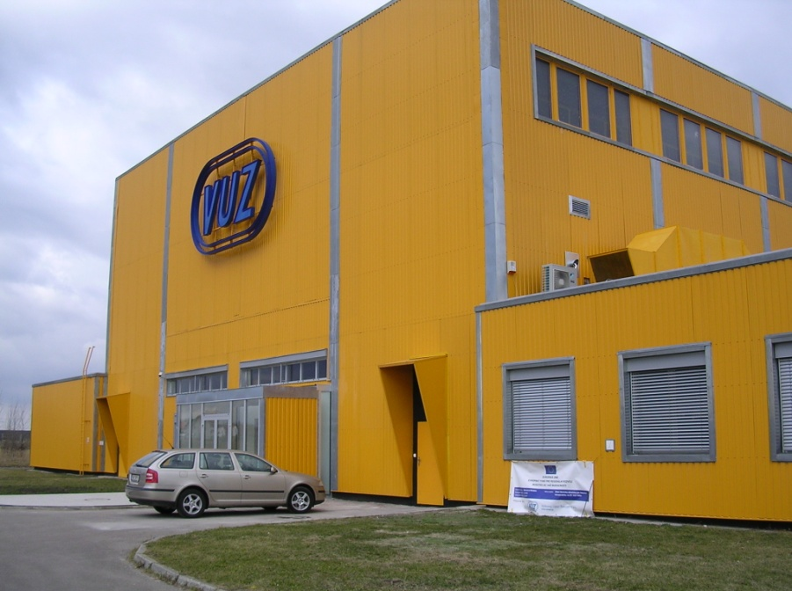
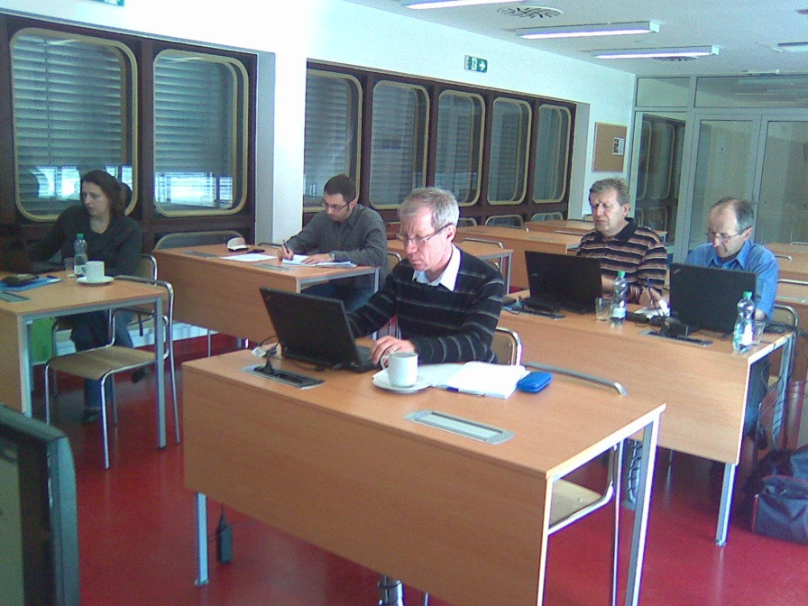
Training Centre for Interoperability of European Railway System
Situated in the Test Centre in Velim, Railway Research Institute;
Capacity 20 persons

Slide 8
Operational Programme Education for Competitiveness (OP EC)
Call 2.4 Partnership and networks
“Support of trainee-ships (short term attachments) and special activities at the tertiary education area innovation” (POSTA)
University of Pardubice, started in 03/2011 with its duration up to 02/2014, 100% sponsorship by the State.
Call 2.3 Human resources in research and development
submitted project “Interoperability of Railway Infrastructure in the Competence Network” (IRICoN)
TP network at the national and European level concerning to railway interoperability and with a constitution of “mirror groups”;
Brno University of Technology , supposed start in 01/2012 with duration up to 12/2014, 100% sponsorship by the State.

Slide 9
Interoperability of Railway Infrastructure in the Competence Network (IRICoN)
DG MOVE
DG RTD
RISC
ERRAC
IRRB
Evropská úroveň
NBRail
ERA
CER
UNIFE
UIC
Conformity Survey Group
Infrastructure
Energy
CCS
INF/RST/NOI
Infrastructure
Energy
CCS
INF/RST/NOI
RCG
European Training ERTMS
Mezinárodní spolupráce
Koordinace
Národní úroveň
Zrcadlové skupiny
TP Interoperabilita železniční infrastruktury
Školící středisko pro IŽI (VUZ)
IRICoN
MG CCS
MG Research
MG SySo
MG Energy
MG IRRB
MG INFR

Slide 10
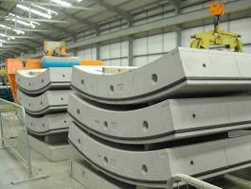
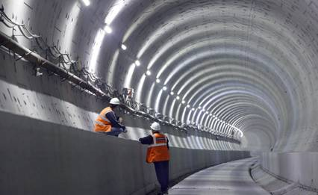
Project of Czech Science Foundation
Development and testing fiber-concrete characteristics fulfilling present requirements for transport tunnel lining:
Parameters of fiber concrete segments will be compared with the parameters of commonly reinforced segments. The project results should clearly show the advantages and disadvantages of new material. It is expected an immediate use at RIA.
Expected benefit: reduction of steel consumption, simple production, fire resistance.

Slide 11
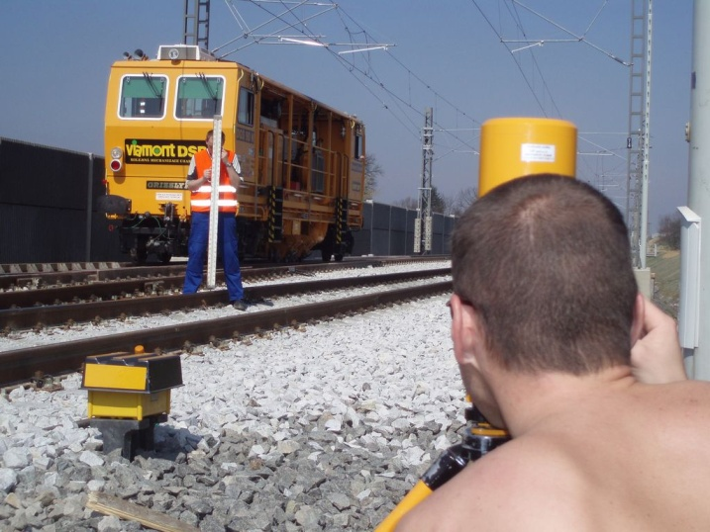
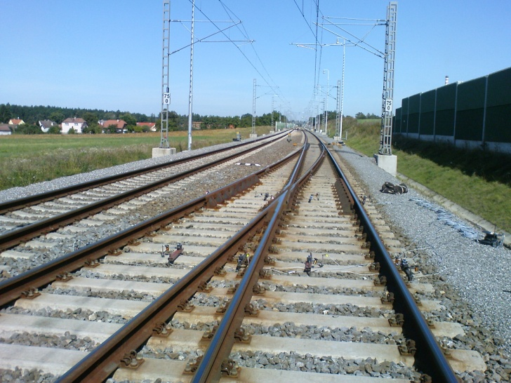
Programme ALFA of the TACR (examples) the subsystem “Infrastructure”
Improvement of track quality in switches and crossings due to the increased flexibility
01/2011 – 12/2016;
DT výhybkárna a strojírna, a.s. / Czech Technical University in Prague / Brno University of Technology.
Sleepers and bearers with under sleeper pads
01/2011 – 12/2014;
Brno University of Technology / ZPSV, a.s.

Slide 12
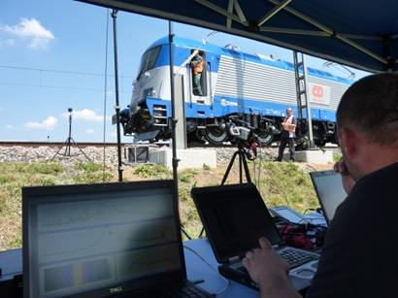
Programme ALFA of the TACR the subsystem “Interface / RST / NOI”
Project NOVIBRAIL (NOise emission and VIBration in RAILway system),
project leaded by VUZ with cooperation of University of Pardubice and VUKV (Research Institute for Rolling Stock),
duration 01/2011- 12/2013,
main aims:
to evaluate effectiveness of present protections against railway noise and vibration;
to analyse noise emission at the determinate railway track sections;
to analyse influence of the ground vibration propagating in ground and its connection with noise emissions;
to analyse influence of rail acoustic roughness to noise emissions radiation of rolling stock;
to evaluate relations between the technical specification for interoperability (TSI) relating to the subsystems "rolling stock - noise" and "infrastructure" of the trans-European conventional rail system;
to evaluate possibility of use a simulation of rolling stock noise quality;
to evaluate possibility, design and verify a technology for rust scale off from running rail surface;
to prepare an economical costs analysis for vehicles homologation with influence of TSI, ENs, ISO and other standards.

Slide 13
TP Member’s Participation in European programmes
FP6: RailEnergy (VUZ), Europac (VUZ), RailCom (VUZ), INNOTRACK (CVUT, RIA)
FP7:
Call 1:
INESS (AZD)
Call 2:
ERRAC Road Map
TP delegates its representatives into three WPs as experts:
WP4 – Mr. Vladimír Kampik (AZD);
WP5 – Mr. Mojmir Nejezchleb (ZPSV);
WP6 – Mr. Petr Kavan (VUZ).
Call 4:
EUREMCO (VUZ);
MAINLINE (SKANSKA);
D-Rail (VUZ).
FP8: Ministry of Education, Youth and Sports involved TP proposal to the railway part into “Outline of the approach of the Czech Republic to the preparation of the 8th Framework Programme”

Slide 14
Czech Technological Platform and UIC-IRRB
TP will support the reflection of conclusions of the new White Paper on Transport Policy into national objectives – i.e. strengthening of the position of rail transport in traffic system.
The Czech Technological Platform is an efficient means for the realization of its objectives and it has been awarded the support of top state institutes of the Czech Republic in the field of railway transport.
TP is by the European organizations considered as a “pilot project” uniting research and development with real business needs and business opportunities in the field of railway industry and civil engineering.
TP is ready to cooperate with UIC-IRRB and offers its highly professional capacities of Expert Groups, the Evaluators Board and constituted networks.

Slide 15
Thank you for your attention
Otto Plášek, Assoc.prof., MSc., Ph.D.
Brno University of Technology, Faculty of Civil Engineering
email: plasek.o@fce.vutbr.cz

