Slide 1
Czech National Technology Platform Interoperability of Railway Infrastructure
Jaroslav Vasatko
VUZ - Railway Research Institute, j.s.c. – CZTP member
Adviser of Director General VUZ
Prague, September 4th, 2014

Slide 2
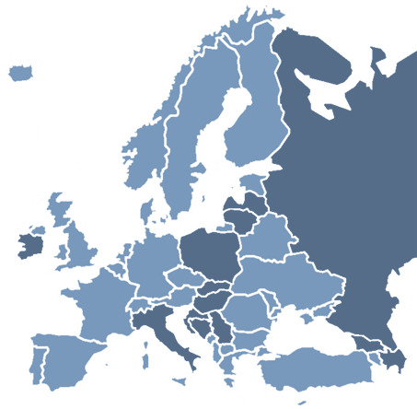
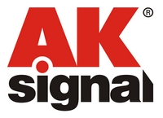
Czech National Technology Platform (CZTP)

Slide 3
CZTP - members structure
14 industrial companies from the Czech Republic that are active in:
Construction of railway lines
Electrification of railway lines
Production of Control, Command and Signalling systems
5 faculties of 4 universities, 1 college
Czech Technical University in Prague, University of Pardubice, Brno University of Technology, Technical University of Ostrava, College and Secondary School
of Machinery Engineering and Transportation, Děčín
3 research institutes and 2 design institutes
1 state organization
Railway Infrastructure Administration

Slide 4
CZTP - members
Manufacturing and Construction Companies:
Construction of railway lines:
SKANSKA a.s., Subterra a.s., MCO a.s., EDIKT a.s., Dosta Tábor s.r.o., DT Výhýbkárna a strojírna, a.s., ŽPSV a.s.
Electrification of railway lines: EŽ a.s., Trakce a.s.
Production of Control, Command and Signalling systems:
AŽD Praha s.r.o., AK Signál Brno a.s., Starmon s.r.o.
Research and Project Centres:
VUZ a.s., VÚKV a.s., TZUS Praha, s.p., SUDOP Praha a.s.
Universities and Higher and Secondary College:
ČVÚT Prague (Transport Faculty), UPCE (Jana Pernera Transport Faculty), College and Secondary School of Machinery Engineering and Transportation – Děčín, VÚT Brno (Transport Faculty, Faculty of Civil Engineering, Institute of Railway Structures and Construction), VŠB – Technical University in Ostrava
State Organisation: SŽDC s.o.

Slide 5
Memorandum of Cooperation
ERRAC
PTFE (Plataforma Technológica Ferroviaria Española)
ČVUT v Praze (Czech Technical University in Prague)
ACRI (Association of the Czech Railway Industry)
UPV ČR (Industrial Property Office, Czech Republic)
ČD, a.s. (Czech Railways, j.s.c.)

Slide 6
CZTP - organizational structure
Research and Development Council
Management Board (MB)
Control and Revision Commission
CZTP Members
International (European) Network of Interoperability
Chairmanship of the Management Board
Technology Platform Networks (R&D, Testing Engineering, Training)
Board of Evaluators
Chairman of the MB
Vice Chairman of the MB
Vice Chairman of the MB
Executive Director
Project team: IAP
Secretary of the Chairman of the MB
Project Implementation POSTA, IRICoN, Foster Rail
Coordinator of International Cooperation
Expert Group of Infrastructure
Expert Group of Energy
Expert Group of Control, Command and Signalling
Expert Group of Interface
Implementation of Projects, Management of Projects, Professional Activities

Slide 7
Areas of CZTP activities
At the national level - national nets:
Research and development
Testing
Education and training
Others activities
At the international level - European nets:
Interoperability of railway infrastructure with the participation of Czech experts and executive managers
Members in expert group of ERA, CER, UIC, NB-Rail
Participation in the solution of international projects
Cooperation with ERRAC and National Technology Platform
Cooperation with other European Technology platform
Others activities

Slide 8
National and European Activities
European Commission
consulting
RISC
DG MOVE
DG ENTR
DG RTD
DG REGIO
European
RPW
European Association of Railway Companies
European Association of Railway Industry
ERRAC
coord.
EuropeanTechnol. Platform
ERA
N.B.Rail
UNIFE
EFRTC
CER
UIC
EIM
Supportive
and
expert groups
Supportive
and
expert groups
Authorities, Institutions
MD
MPO
TP share on activites of working groups
Representation of the CR participstion in expert groups
TAČR
MŠMT
Participation TP
expert
Cooperation
CzechInvest
GAČR
SŽDC
OPPI
Preparation of regulations for the European railway interoperability
OP VK
National
Participation of
TP expert groups
project
proposals
OP D
Technology Platform
Projects proposed by the TP
Continuing cooperation

Slide 9
Main benefits of CZTP
Connecting universities, rail industry
and users (SZDC)
Professionally qualified team in the area of railway transport - advisory body for the Ministry of Transport
Participation in research projects on railway interoperability
Experience with creating and assessing of basic
strategic documents in the field of railway
transport (for government agencies)
Basic professional focus on infrastructure, control,
command and signalling,energy and interface
(track/wheel)

Slide 10
CZTP proposals for possible future cooperation
Participation in the project Shift2Rail
Our assumptions:
We can offer professional capacities of universities, research and development institutions
We can provide experimental bases - accredited laboratories and testing centers (Test Centre VUZ Velim)
We cooperate on the project Foster Rail that is linked with project Shift2Rail
Contact the cooperation over the members of AZD and VÚKV
The form of participation – open calls, subcontracts
We would like to participate on program HORIZON 2020
Other possibilities of cooperation for example :
coordination in the development and maintenance of TSI
and others

Slide 11
Thank you for your attention!
Jaroslav Vasatko, VUZ – CZTP member
Adviser of Director General VUZ
Prague, September 4th, 2014

