Slide 1
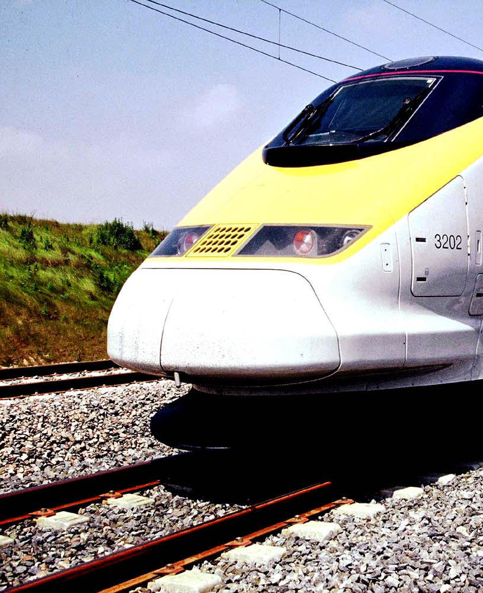
Current status of the European Research Program HORIZON 2020 and SHIFT2RAIL
Dennis Schut
Praha, 26 August 2015

Slide 2
Horizon 2020 – WP 2016 – 2017 Call for Proposals Overview

Slide 3
Horizon 2020
Pillar 1
Excellent Science
Pillar 2
Industrial Leadership
Pillar 3
Societal Challenges
€77bn
European Research Council (ERC)
Future Emerging Technologies (FET)
Marie Curie - Training networks, Fellowships, Innovation Exchange
Research Infrastructure
Leadership in enabling and industrial technologies
ICT; micro- and nanoelectronics, photonics; nanotechnology; biotechnology; advanced materials and advanced manufacturing systems
Innovation for
SME’s
Societal Challenges
1. Health, demographic change and well-being
2. Food security, sustainable agriculture, marine and maritime research, and the bioeconomy
3. Secure, clean and efficient energy
4. Smart, green and integrated transport
5. Climate action, resource efficiency and raw materials
6. Inclusive, innovative societies
7. Secure societies
Top
Down
Top
Down
Bottom up
€0.92bn
European Institute of Technology. Euratom. JRC’s
26-Aug-15
3
Notes:
This is an overview of H2020 and all of the areas the EC wants to address.
S2R is only a small ring-fenced part of the overall budget
3

Slide 4
Horizon 2020 – WP 2016 – 2017 Call for Proposals Challenge 4 « Smart, green & integrated transport » (NB: NO rail-only topics! – only co- & multi-modal topics) (Rail-only = inside S2R!)

Slide 5
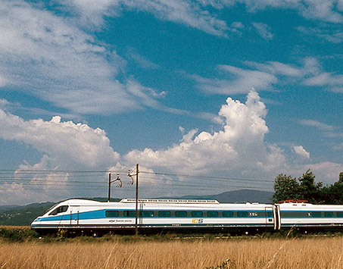
From the DRAFT Work Program 2016/17, version June 2015 - Transport related issues
New in this version:
➔ Additional and redesigned calls in aviation
➔ New “New ways of supporting development and implementation of neighbourhood-level and urban-district–level transport innovations”
More “Other Actions”
Opening of the Call – (not certain yet) - 30 September 2015
1st Stage deadline: 20 January 2016
2nd Stage deadline: 29 September 2016

Slide 6
Horizon 2020 – WP 2016 – 2017 Call for Proposals Potentially interesting topics for rail stakeholder involvement

Slide 7
1. MG-6.1-2016.
Innovative concepts, systems and services towards 'mobility as a service‘
• Multi-modal, cross-border traffic management, information and planning systems, to serve passengers and/or other users.
• Analysis of the range of services to be made accessible under each interface, by taking into account differences between various user groups.
• Identification of the success and failure factors of the new concept(s), such as mobility as a service, with particular attention to the users' acceptance factors.
• Identification of the necessary framework (regulatory, technological, financial, etc.) to support the implementation of new services, including the needed private-public collaboration requirements.
• Identification and development of viable business models suitable for future market take-up.
• Identification and validation of measures apt to induce socially-responsible (e.g. vis-à-vis the environment) travel behaviours and advanced planning (e.g. via integrated intermodal paperless ticketing).
EU intended contribution 3 - 3.5 millions
Interest Multimodal research
EU Total budget 25 millions

Slide 8
2. MG-3.4-2016.
Transport infrastructure innovation to increase the transport system safety at modal and intermodal level (including nodes and interchanges)
Infrastructure safety improvement by design and upgrading; new design methods and re-engineering to make infrastructure self-explaining and forgiving, including issues related to vulnerable users.
Efficient maintenance methods to ensure continuity of high safety performance while allowing longer life-cycles of the infrastructure; development of embedded monitoring systems aimed at the implementation of predictive maintenance methods.
Elaboration and implementation of the concept of transport infrastructure maintenance cycle, optimising all stages of maintenance, including design, monitoring, planning, as well as approaches to take account of other productive or leisure activities using the same infrastructure (e.g. inland waterways) and supporting decision-making between maintenance and structural interventions.
Adaptation of the infrastructure to new vehicles characteristics, including V2I/I2V systems and information sharing.
Improved safety in work zones and in links and interchanges at risk
Particular attention has to be paid to links and interfaces between modes (e.g. level crossings). Integrated safety management systems will be required.
EU intended contribution 2 – 5 millions
Interest Multimodal research
EU Total budget 12 millions

Slide 9
3. MG-7.3-2016.
The Port of the future
1) Research and innovation actions should address several of the following aspects:
Multi-modal optimised cost-effective and flexible operations inside the terminal and in the wider port area. Re-engineering of port operational processes via process analysis and identification of updated ICT systems to improve the level of integration among all actors (Port Authorities, terminal operators, shipping companies, customs, security forces, etc.) and facilitate critical decision-making.
Advanced and efficient links and integration in the socio-economic industrial and urban surrounding environment efficient connections with the hinterland transport network.
Efficient connections with the hinterland transport network contributing to an increased use of the most energy-efficient transport modes, in particular rail.
Inland waterways and short sea shipping ports deserve particular attention. Proposals should consider the possible transferability of solutions to other ports and multimodal hubs such as rail-freight terminals, inter-ports, airports and dry ports.
2) Coordination and support actions should focus on clustering retained proposals, identifying appropriate KPIs and relevant monitoring and evaluation of results of actions stemming from this call, from other calls of this programme and other ongoing activities in the sector.
EU intended contribution 3 - 5 millions (RIA) up to 1 million (CSA)
Interest Multimodal research
EU Total budget 37 millions (RIA) 1 million (CSA)

Slide 10
4. MG-8.1-2016.
Research, technology development and market trends for the European transport manufacturing industries
Analyse the investment trends, productivity levels, technology choices and options, industrial strategies, research and technology development capabilities and funding efforts of the European producers of transport means, including manufacturers of vehicles, equipment, components and systems, in the automotive, aeronautical, ship-building and rail vehicle industries.
Assess the competitive advantages and disadvantages of those industries in relation to their main competitors world-wide, including new players from other areas who are active in new fields like automation; project their global market share prospects and predictable employment level scenarios.
Analyse the economic potential of new technologies, products and markets and their role in the determination of the industrial and commercial strategies of the major players; and assess the success factors of those strategies.
Consider the incidence of legislation and regulation at national and supranational level on industrial practices, innovation potential and global competitiveness.
EU intended contribution 0.5 – 1.5 millions
Interest Multimodal research
EU Total budget 1.5 Millions

Slide 11
5. MG-8.3-2016.
Assessing future requirements for skills and jobs across transport modes and systems
Explore the impact of the deployment of new technologies new business models, growing internationalisation, increased intermodality and interdisciplinarity of transport activities on employment profiles and identify future requirements of skills and competences across all skill levels of the transport workforce.
Identify critically review (and benchmark) existing and/or innovative training and learning methods and tools with a view to address the needs of the workforce in transport modes and systems of a growing complexity.
Identify critical issues to be addressed and subjects to be taught in order to meet the future needs of transport across all skills levels; identify and/or propose specific curricula for training in particular for the mid-low skilled workers and those who need to upgrade their skills through lifelong learning.
Define the competences of trainers and design new profiles of teams devoted to facilitating the transfer of knowledge through innovative ideas/methods.
EU intended contribution 2 – 3 millions
Interest Multimodal research
EU Total budget 3 Millions

Slide 12
The EC Info Day on the Horizon 2020 Work programme 2016-2017 ‘Smart, green and integrated transport’ is scheduled for 5 November 2015 in Brussels
http://ec.europa.eu/research/index.cfm?pg=events&eventcode=D7185674-DE6C-2C3A-6BFC1426216A4F51

Slide 13
Horizon 2020 – WP 2016 – 2017 Call for Proposals potentially interesting topics from the non-transport challenges (other than Challenge 4)

Slide 14
2016 Horizon 2020 topics outside of
“Smart, green and integrated transport”
Leadership in enabling and industrial technologies - Information and Communication Technologies
Advanced computing and cloud computing: Cloud Computing
Future Internet: 5GPP Research and validation of critical technologies and systems; Net innovation factory; Future Internet experimentation – Building a European experimental infrastructure
Content: Big data PPP: 1) Innovation hubs for cross-sectorial and cross-lingual data integration; 2) Innovation hubs for cross-sectorial and cross-lingual data experimentation; 3) Large scale pilot projects in sectors best benefiting from data-driven innovation; 4) Research addressing main technology challenges of the data economy; 5) Privacy-preserving big data technologies
Robotics and Autonomous Systems: Market driven research and innovation in robotics
Internet of Things: Large scale pilots; IoT Horizontal activities; R&I on IoT integration and platforms
Security: Assurance and Certification for Trustworthy and Secure ICT systems, services and components
International Collaboration: EU-Japan: IoT/Cloud/Big data platforms in social application contexts
A future driven by Innovation
Notes:
Leadership in enabling and industrial technologies - Information and Communication Technologies
Advanced computing and cloud computing
ICT2.2 – 2016: Cloud Computing
Future Internet
ICT3.1-2016: 5GPP Research and validation of critical technologies and systems
ICT3.6-2016: Net innovation factory
ICT3.7-2016: Future Internet experimentation – Building a European experimental infrastructure
Content
ICT4.1–2016: Big data PPP: Innovation hubs for cross-sectorial and cross-lingual data integration
ICT4.2–2016: Big data PPP: Innovation hubs for cross-sectorial and cross-lingual data experimentation
ICT4.3–2016: Big data PPP: Large scale pilot projects in sectors best benefiting from data-driven innovation
ICT4.4–2016-17: Big data PPP: research addressing main technology challenges of the data economy
ICT4.6–2016: Big data PPP: Privacy-preserving big data technologies
Robotics and Autonomous Systems
ICT5.2–2016: Market driven research and innovation in robotics
Internet of Things
ICT7.1-2016: Large scale pilots
ICT7.2-2016: IoT Horizontal activities
ICT7.3-2016: R&I on IoT integration and platforms
Security
ICT8.1–2016: Assurance and Certification for Trustworthy and Secure ICT systems, services and components
International Collaboration: EU-Japan
EUJ2–2016: IoT/Cloud/Big data platforms in social application contexts

Slide 15
Technology & Innovation Team
2016 Horizon 2020 topics outside of
“Smart, green and integrated transport”
Societal Challenges - Secure, Clean and Efficient Energy
Energy Efficiency: Smart Cities and Communities solutions integrating energy, transport, ICT sectors through lighthouse (large scale demonstration - first of the kind) project
Societal Challenges - Secure Societies
Critical Infrastructure Protection: Prevention, detection, response and mitigation of physical and cyber threats to elements of the European critical infrastructure
Security: Integrated tools for response planning and scenario building
SME instrument topic: Protection of urban soft targets and urban critical infrastructures
Fast track to Innovation – Pilot:
Digital Security: Cyber Security for SMEs and Individuals
A future driven by Innovation
Notes:
3 Societal Challenges - Secure, Clean and Efficient Energy
Energy Efficiency
SCC 1 – 2016/2017: Smart Cities and Communities solutions integrating energy, transport, ICT sectors through lighthouse (large scale demonstration - first of the kind) project
7 Societal Challenges - Secure Societies
Critical Infrastructure Protection
CIP 1 - 2016 and 2017: "Prevention, detection, response and mitigation of physical and cyber threats to elements of the European critical infrastructure"
Security
SEC - DRS 1 - 2016: Integrated tools for response planning and scenario building
SME instrument topic:
SEC-GM2 - 2016-17: Protection of urban soft targets and urban critical infrastructures
2016 and 2017 Fast track to Innovation – Pilot
SEC – GM3 FTI
Digital Security
DS1 – 2016: Cyber Security for SMEs and Individuals

Slide 16
Current status of Shift2Rail heavy delays

Slide 17
S2R Organisation: There is still no Director for the Shift2Rail Undertaking but some staff - about 5 - has been recruited for the S2R secretariat
The Call for Associated Members has been evaluated and decisions made. One of the Associated Members is a consortium of UIC members – EUROC. EUROC does not participate in all IP’s
All Memberships Agreements will be signed in November 2015
An Annual Work Plan for 2015 and for 2016 has been drafted, both to be started 2016
The S2R Multi Annual Action Plan is to be developed, starting now, first draft to be ready early October 2015 and final in November
The Model Grant Agreement will be decided in December 2015
The first S2R Open Call for proposals might be opened in December 2015 or January 2016

Slide 18
Thank your for your attention!

